Slide 1
June 2
Week 1, Day 1

Slide 2
Hi!

Slide 3
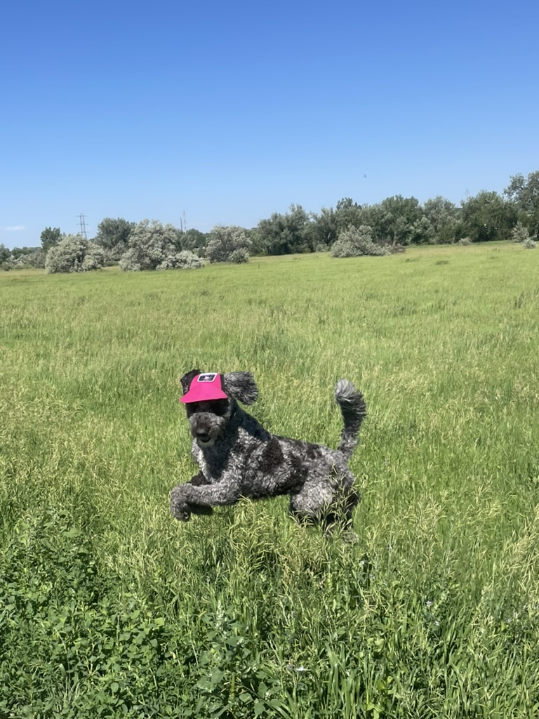

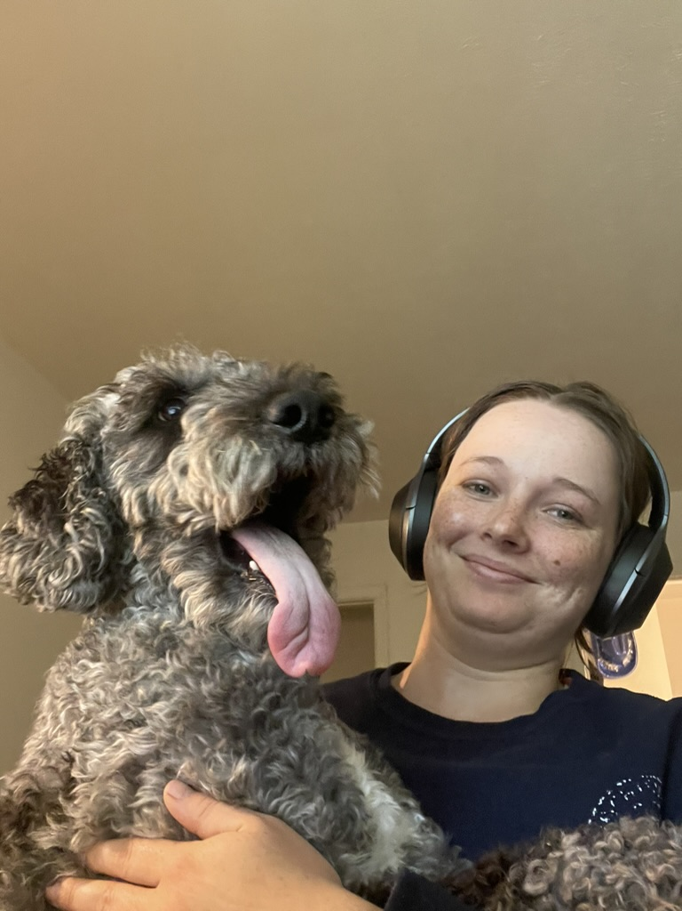
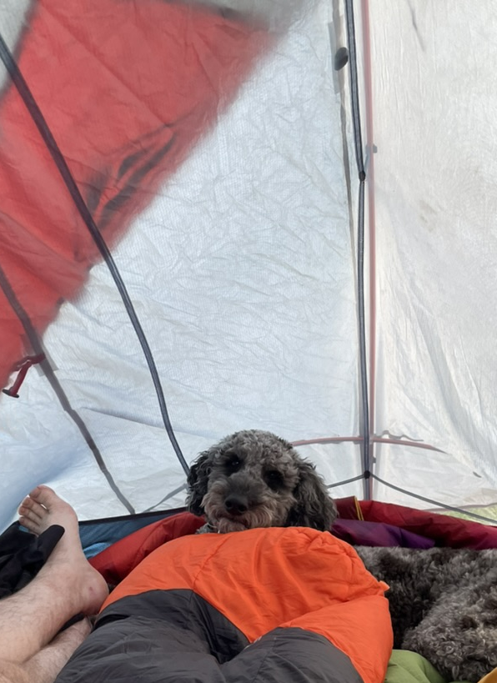

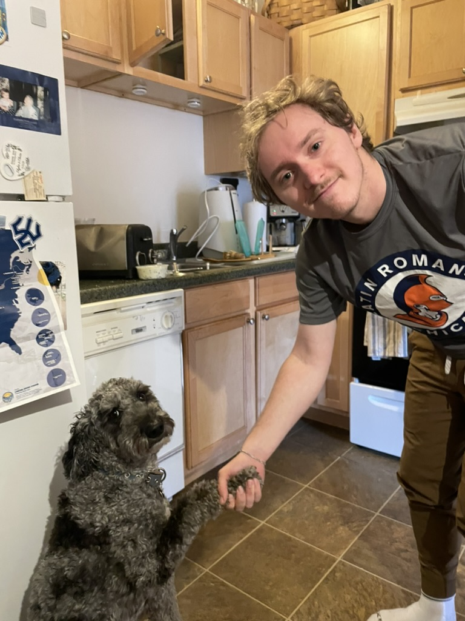

Slide 4
Syllabus

Slide 5
Where You Can Find It

Slide 6
Overview
If you need to contact me for any reason, please make sure to use the canvas. I will not answer emails.

Slide 7
Office Hours
Where to find it:
Every Tuesday from 1pm – 2pm MT Remote
Zoom Link:
Sign Up on Canvas through the calendar. If no one has signed up there is a possibility that I might not be there.

Slide 8
Schedule
Week | Topic
Week 1 | Course Expectations and Python
Week 2 | Python
Week 3 | Data types/sources (text files, CSVs, JSON, Numpy)
Week 4 | APIs and Beautiful Soup
Week 5 | Data cleaning (Pandas and Ethics)
Week 6 | Exploratory Data Analysis and Data Visualizations
Week 7 | Data Storytelling

Slide 9
Course Outcomes
Identify data sources and characteristics of interest
Have familiarity with various data sources
Have the ability to explore, clean, and analyze data
Communicate findings through documentation and visualization

Slide 10
Assignments
This course is project-based. You will be assigned coursework throughout the course with minimal instructions
All the material for this course will be posted on Canvas.
All assignments must be submitted via GitHub, Canvas, or LinkedIn. DO NOT email your instructor with your assignment, as it will not be accepted.

Slide 11
Extra Credit
There are multiple ways for you to gain extra credit:
If you have your camera on for the entirety of more than 50% of the classes (the full class)
Coming to 2 office hours
These are given as a gift. I will accept explanation and discussion about these sources of extra credit. I will not accept argument and challenges on the topic.

Slide 12
Collaboration Policy
This is a collaborative class please google, please investigate, please copy and paste
it is not permissible to use approaches we haven’t covered in class without providing proper documentation detailing where you learned the approach and a sufficient explanation of the approach IN YOUR OWN WORDS.
THE USE OF ARTIFICIAL INTELLIGENCE TOOLS TO GENERATE CONTENT FOR GRADED SUBMISSIONS ARE STRICTLY PROHIBITED AND WILL RESULT IN AN AUTOMATIC FAILING GRADE IN THE COURSE

Slide 13
Possible break

Slide 14
GitHub

Slide 15
What is it?

Slide 16
What are we going to use it for?
https://github.com/ColeSlattery/info24Project

Slide 17
To do:
Make a github account
Put your github username in the discussion
Sign up for a time with me to check your setup with github and or help you setup your github and dashboard

